Slide 1
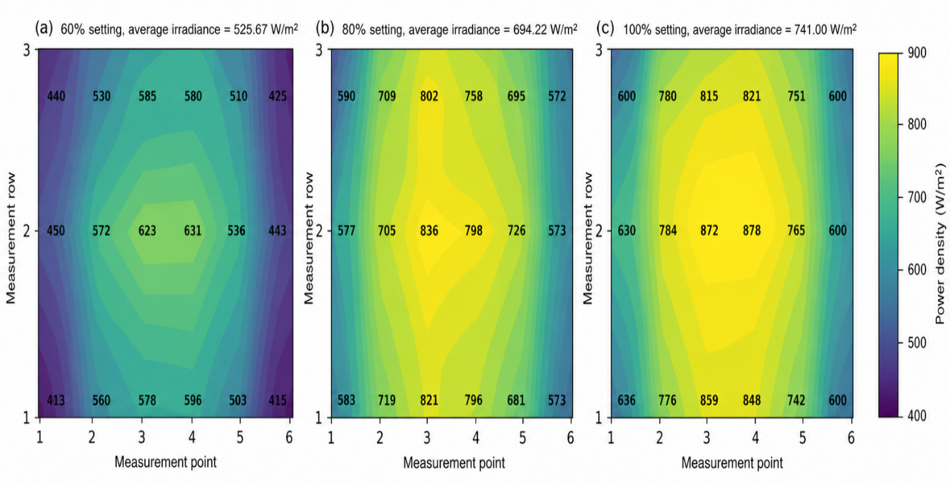
(a) 60% setting, average irradiance = 525.67 W/m²
(b) 80% setting, average irradiance = 694.22 W/m²
(c) 100% setting, average irradiance = 741.00 W/m²
Measurement row | Point 1 | Point 2 | Point 3 | Point 4 | Point 5 | Point 6
3 | 440 | 530 | 585 | 580 | 510 | 425
2 | 450 | 572 | 623 | 631 | 536 | 443
1 | 413 | 560 | 578 | 596 | 503 | 415
Measurement row | Point 1 | Point 2 | Point 3 | Point 4 | Point 5 | Point 6
3 | 590 | 709 | 802 | 758 | 695 | 572
2 | 577 | 705 | 836 | 798 | 726 | 573
1 | 583 | 719 | 821 | 796 | 681 | 573
Measurement row | Point 1 | Point 2 | Point 3 | Point 4 | Point 5 | Point 6
3 | 600 | 780 | 815 | 821 | 751 | 600
2 | 630 | 784 | 872 | 878 | 765 | 600
1 | 636 | 776 | 859 | 848 | 742 | 600

Slide 2
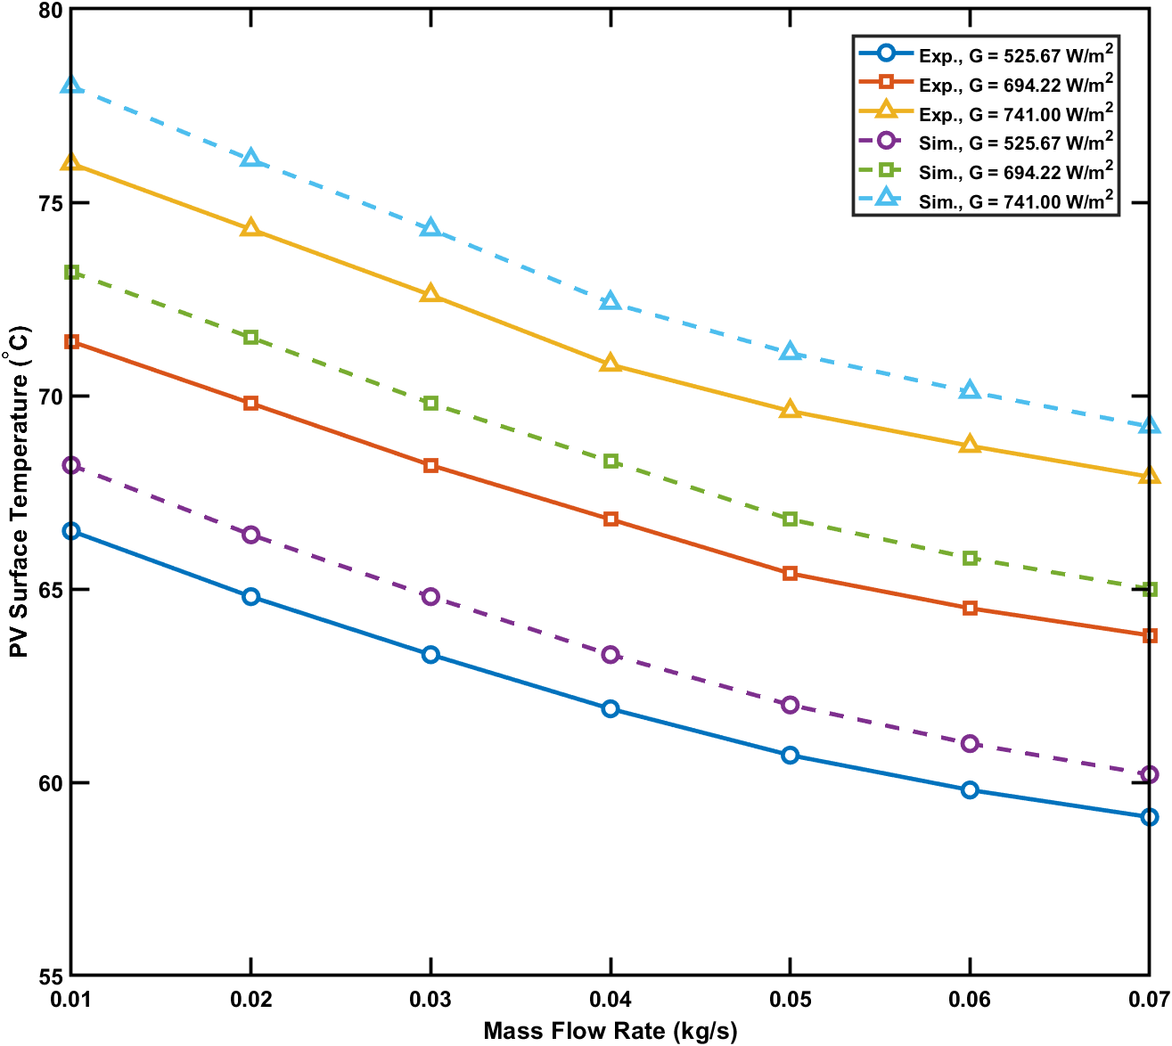
Mass flow rate (kg/s) | Exp. 525.67 W/m² | Sim. 525.67 W/m² | Error (%) | Exp. 694.22 W/m² | Sim. 694.22 W/m² | Error (%) | Exp. 741.00 W/m² | Sim. 741.00 W/m² | Error (%)
0.01 | 66.5 | 68.2 | 2.56 | 71.4 | 73.2 | 2.52 | 76 | 78 | 2.63
0.02 | 64.8 | 66.4 | 2.47 | 69.8 | 71.5 | 2.44 | 74.3 | 76.1 | 2.42
0.03 | 63.3 | 64.8 | 2.37 | 68.2 | 69.8 | 2.35 | 72.6 | 74.3 | 2.34
0.04 | 61.9 | 63.3 | 2.26 | 66.8 | 68.3 | 2.25 | 70.8 | 72.4 | 2.26
0.05 | 60.7 | 62 | 2.14 | 65.4 | 66.8 | 2.14 | 69.6 | 71.1 | 2.16
0.06 | 59.8 | 61 | 2.01 | 64.5 | 65.8 | 2.02 | 68.7 | 70.1 | 2.04
0.07 | 59.1 | 60.2 | 1.86 | 63.8 | 65 | 1.88 | 67.9 | 69.2 | 1.91
Fig. 11. Numerical–experimental comparison of PV surface temperature under different irradiance levels.

Slide 3
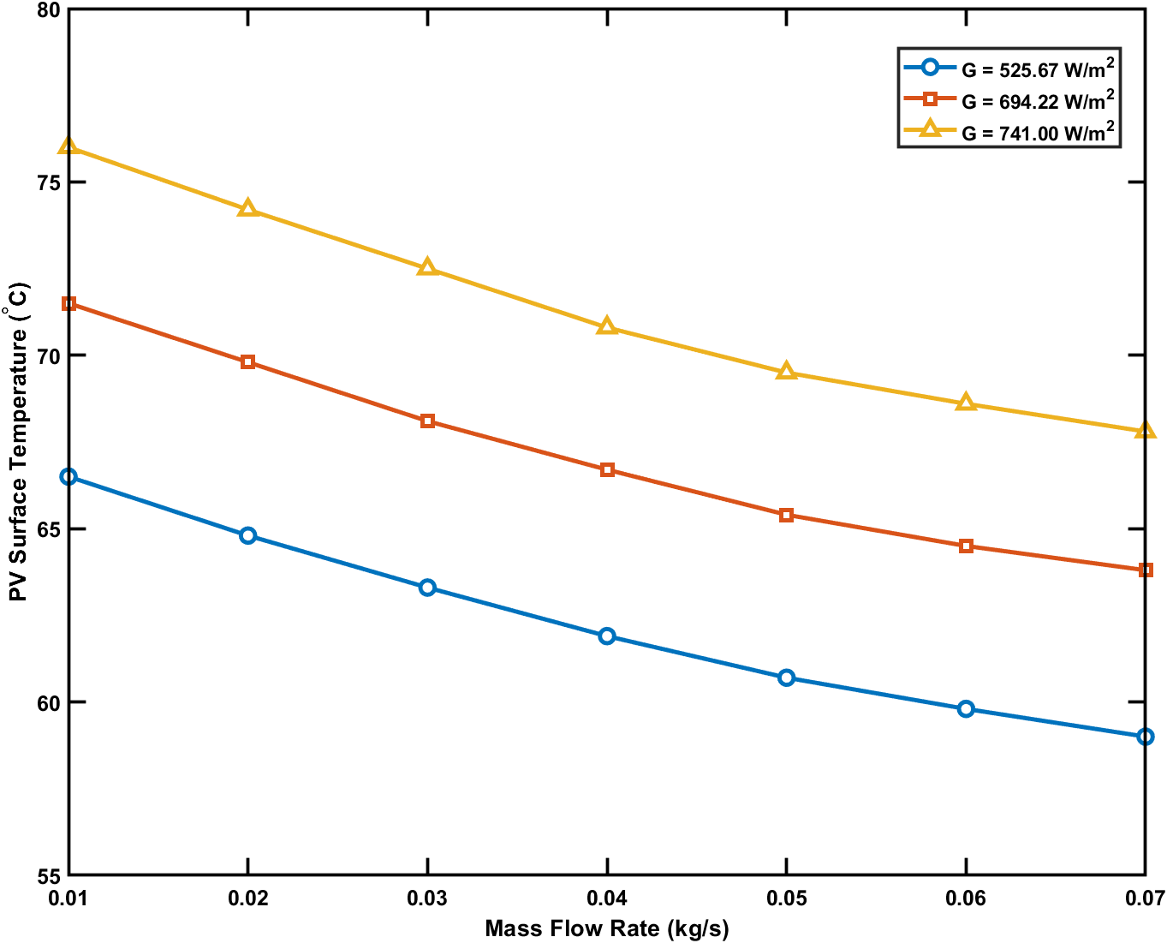
Mass flow rate (kg/s) | PV surface temp at 525.67 W/m² (°C) | PV surface temp at 694.22 W/m² (°C) | PV surface temp at 741.00 W/m² (°C)
0.01 | 66.5 | 71.5 | 76
0.02 | 64.8 | 69.8 | 74.2
0.03 | 63.3 | 68.1 | 72.5
0.04 | 61.9 | 66.7 | 70.8
0.05 | 60.7 | 65.4 | 69.5
0.06 | 59.8 | 64.5 | 68.6
0.07 | 59 | 63.8 | 67.8
Fig. 12. PV surface temperature dependence on flow rate in different irradiance values.

Slide 4
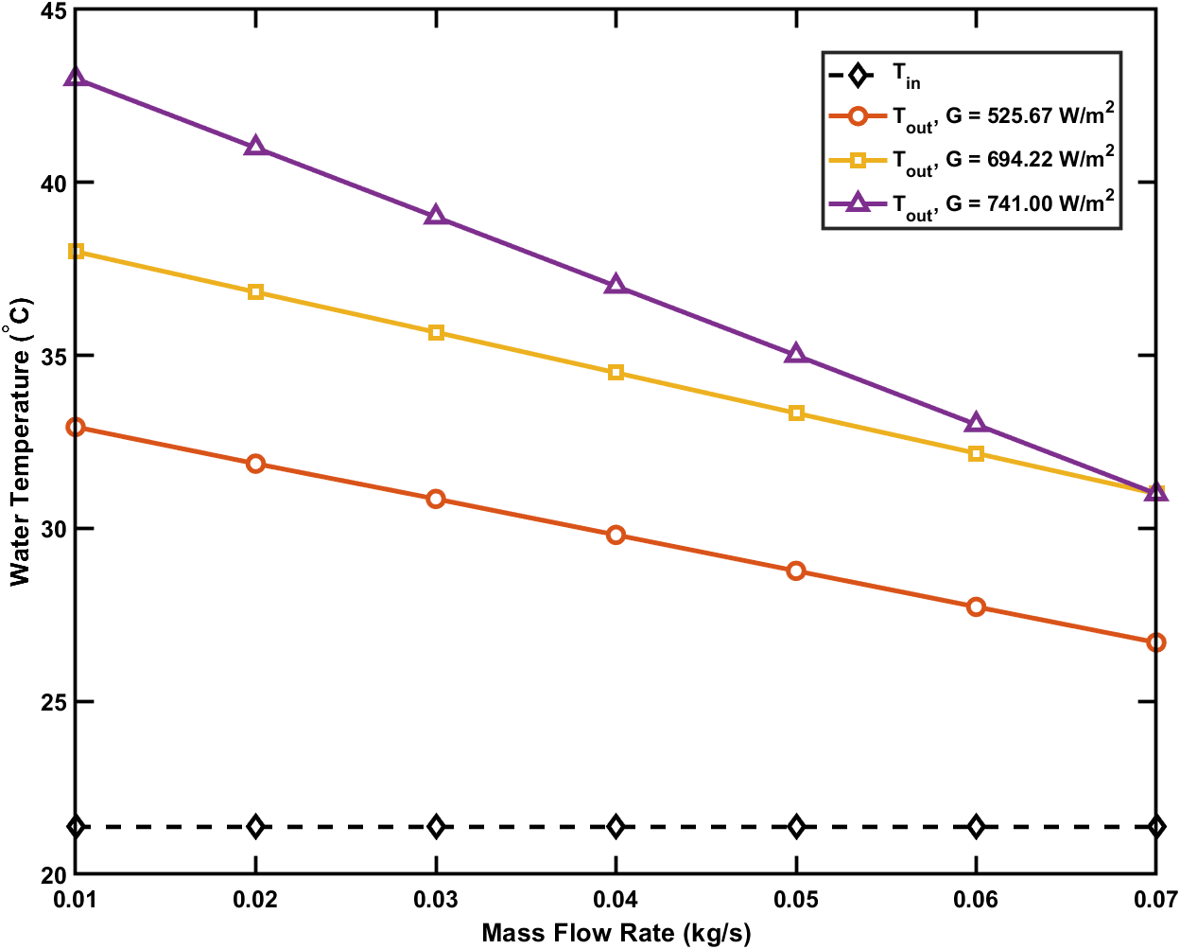
Mass flow rate (kg/s) | Tin | Tout at 525.67 W/m² (°C) | Tout at 694.22 W/m² (°C) | Tout at 741.00 W/m² (°C)
0.01 | 21.37 | 32.93 | 38 | 43
0.02 | 21.37 | 31.87 | 36.83 | 41
0.03 | 21.37 | 30.85 | 35.67 | 39
0.04 | 21.37 | 29.81 | 34.5 | 37
0.05 | 21.37 | 28.77 | 33.33 | 35
0.06 | 21.37 | 27.73 | 32.17 | 33
0.07 | 21.37 | 26.7 | 31 | 31
Fig. 13. Variation of inlet and outlet water temperatures with mass flow rate at different irradiance levels.

Slide 5
14(a)

Slide 6
14(b)

Slide 7
14(c)

Slide 8
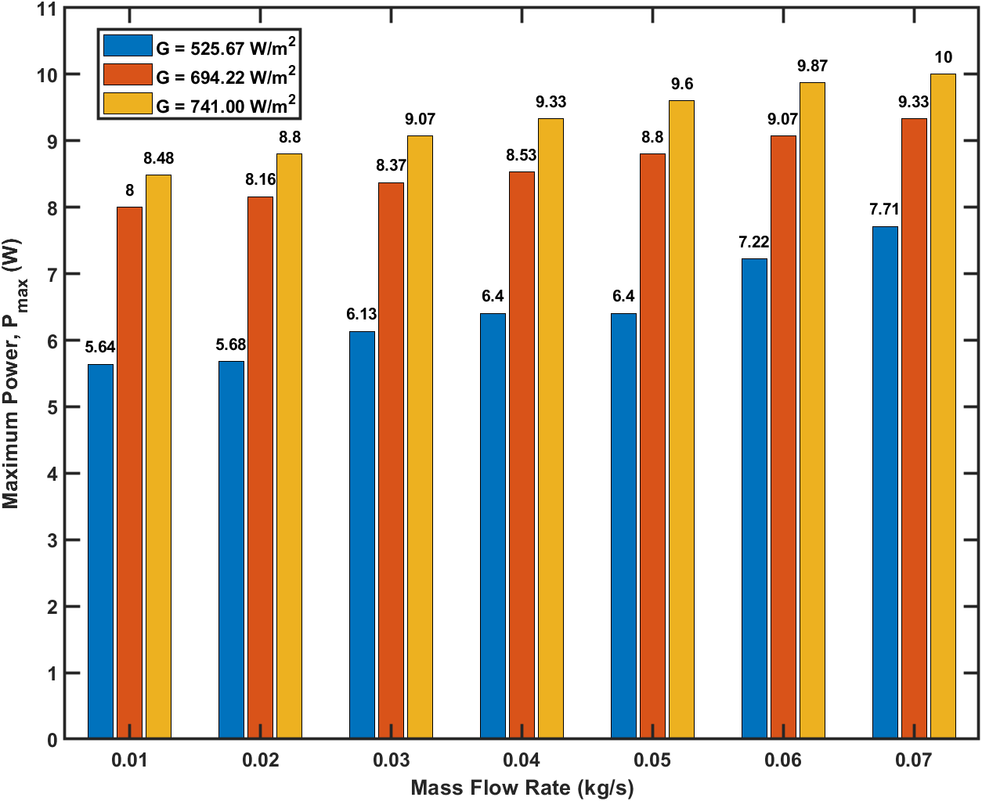
14(d)
Mass flow rate (kg/s) | (P_{max}) at 525.67 W/m² (W) | (P_{max}) at 694.22 W/m² (W) | (P_{max}) at 694.22 W/m² (W)
0.01 | 5.64 | 8 | 8.48
0.02 | 5.68 | 8.16 | 8.8
0.03 | 6.13 | 8.37 | 9.07
0.04 | 6.4 | 8.53 | 9.33
0.05 | 6.4 | 8.8 | 9.6
0.06 | 7.22 | 9.07 | 9.87
0.07 | 7.71 | 9.33 | 10

Slide 9
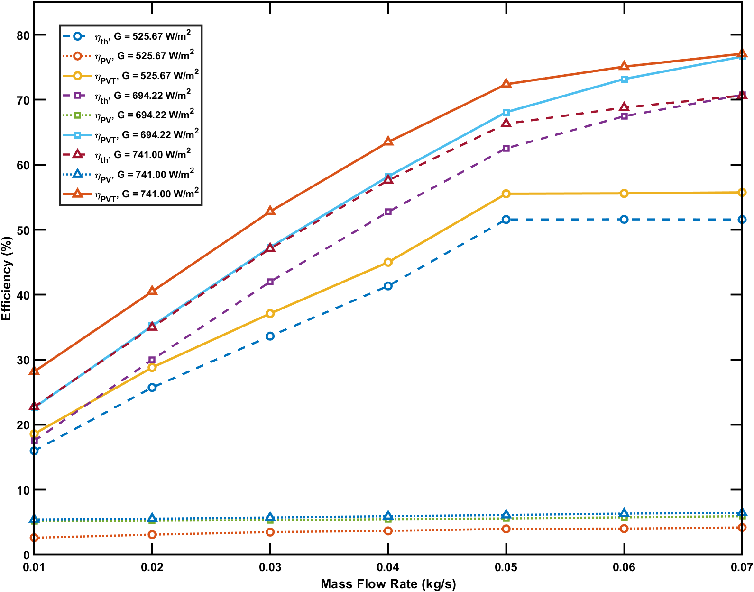
Mass flow rate (kg/s) | ηth 525.67 (%) | ηPV 525.67 (%) | ηPVT 525.67 (%) | ηth 694.22 (%) | ηPV 694.22 (%) | ηPVT 694.22 (%) | ηth 741.00 (%) | ηPV 741.00 (%) | ηPVT 741.00 (%)
0.01 | 15.98 | 2.6 | 18.58 | 17.51 | 5.11 | 22.62 | 22.75 | 5.41 | 28.16
0.02 | 25.72 | 3.08 | 28.8 | 29.99 | 5.21 | 35.2 | 34.98 | 5.52 | 40.5
0.03 | 33.63 | 3.47 | 37.1 | 41.99 | 5.31 | 47.3 | 47.1 | 5.7 | 52.8
0.04 | 41.35 | 3.65 | 45 | 52.75 | 5.45 | 58.2 | 57.6 | 5.9 | 63.5
0.05 | 51.58 | 3.96 | 55.54 | 62.54 | 5.56 | 68.1 | 66.32 | 6.08 | 72.4
0.06 | 51.6 | 4 | 55.6 | 67.47 | 5.73 | 73.2 | 68.8 | 6.3 | 75.1
0.07 | 51.58 | 4.17 | 55.75 | 70.75 | 5.9 | 76.65 | 70.66 | 6.42 | 77.08
Fig. 15. Thermal efficiency, electrical efficiency, and total PVT efficiency as functions of mass flow rate under irradiance levels of 525.67, 694.22, and 741.00 W/m².

